Slide 1
Customer Savings Analytics
By Chisom Ibezim

Slide 2
Introduction
This report aims to provide a comprehensive overview of key customer engagement metrics. By examining trends in total savings, channel utilization, and customer loyalty across different geographical areas, we seek to uncover valuable insights that can inform strategic decision-making and enhance customer relationships.
This report will delve into the nuances of customer behavior, highlighting both successes and areas for potential growth.

Slide 3
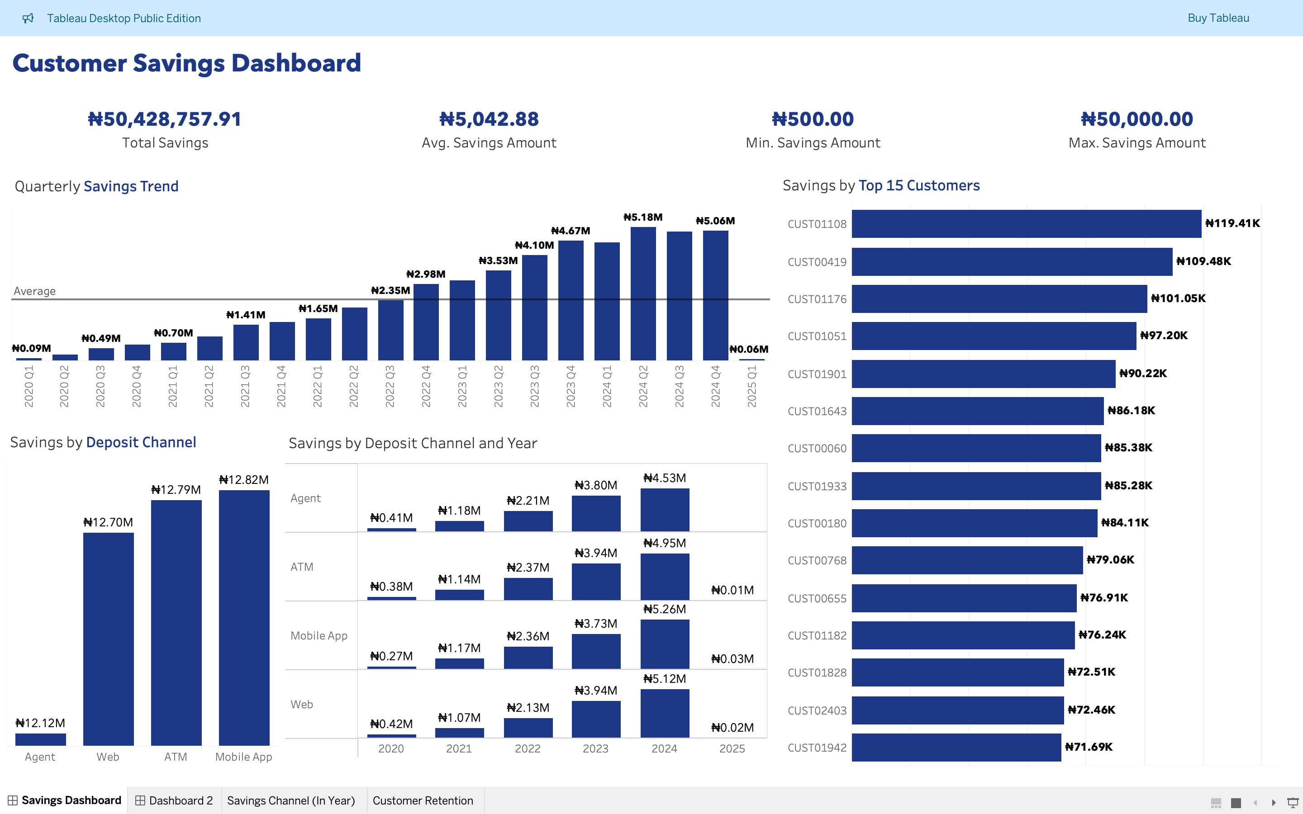
The dashboard above reveals a healthy growth in customer savings over time, with the Mobile App and ATM being the most utilized deposit channels. The top customers contribute a significant portion of the total savings. However, the projected figures for Q1 2025 and the overall 2025 savings by channel suggest a potential slowdown or decrease in savings compared to the peak observed in 2024. This warrants further investigation to understand the underlying reasons.

Slide 4
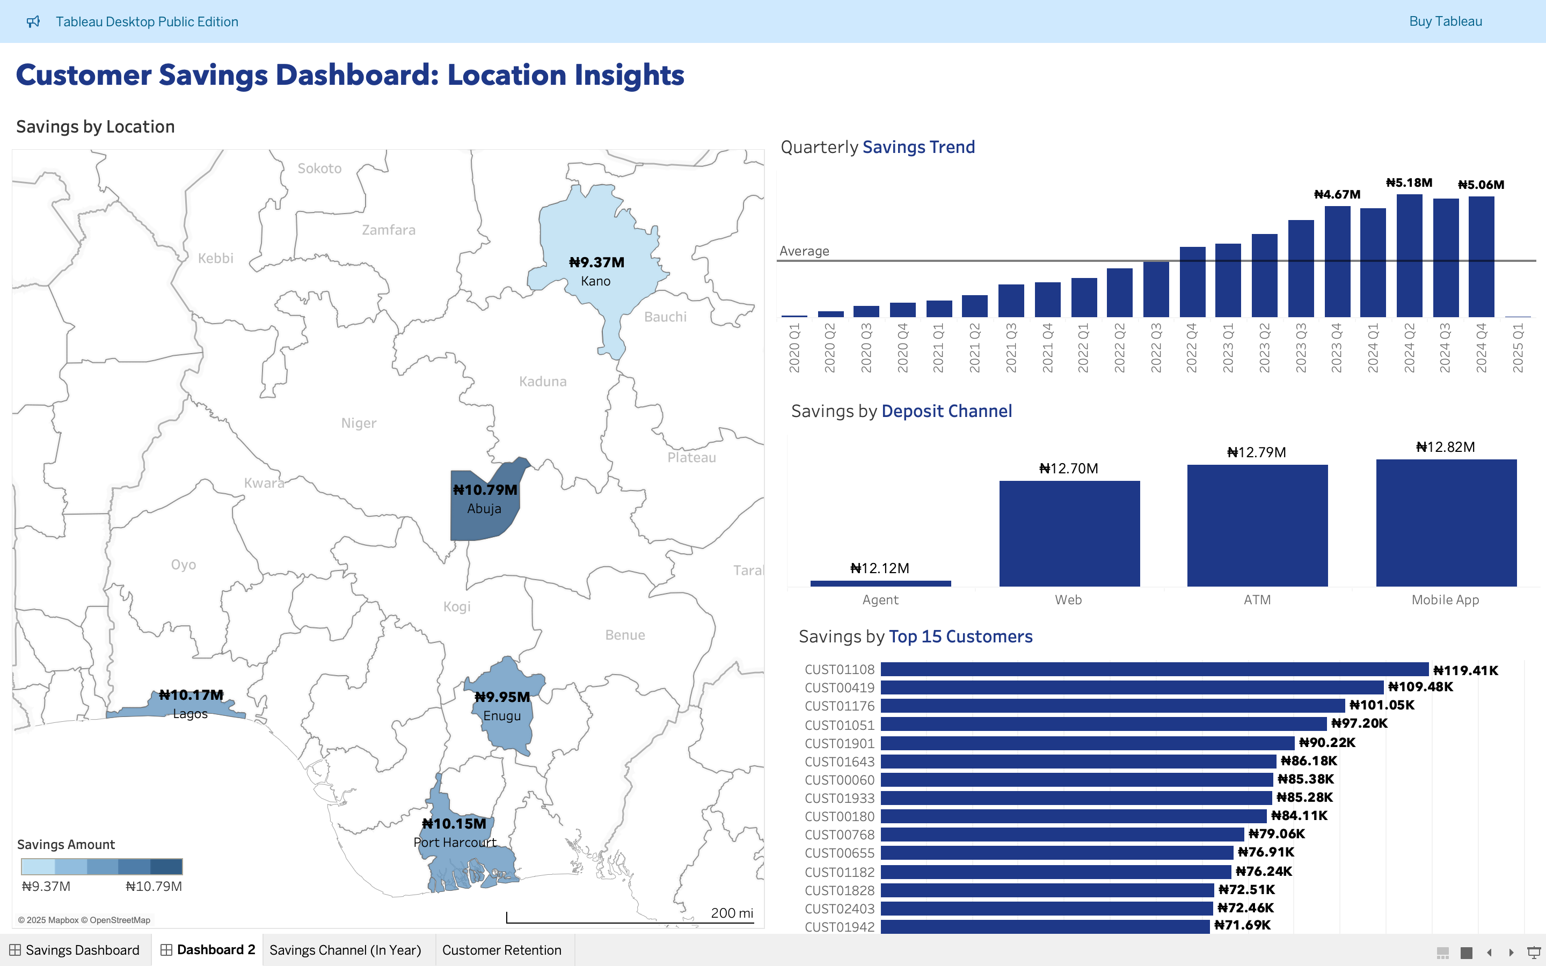
This dashboard provides a geographical perspective on customer savings. Lagos, Abuja, and Port Harcourt stand out as the locations with the highest total savings.

Slide 5
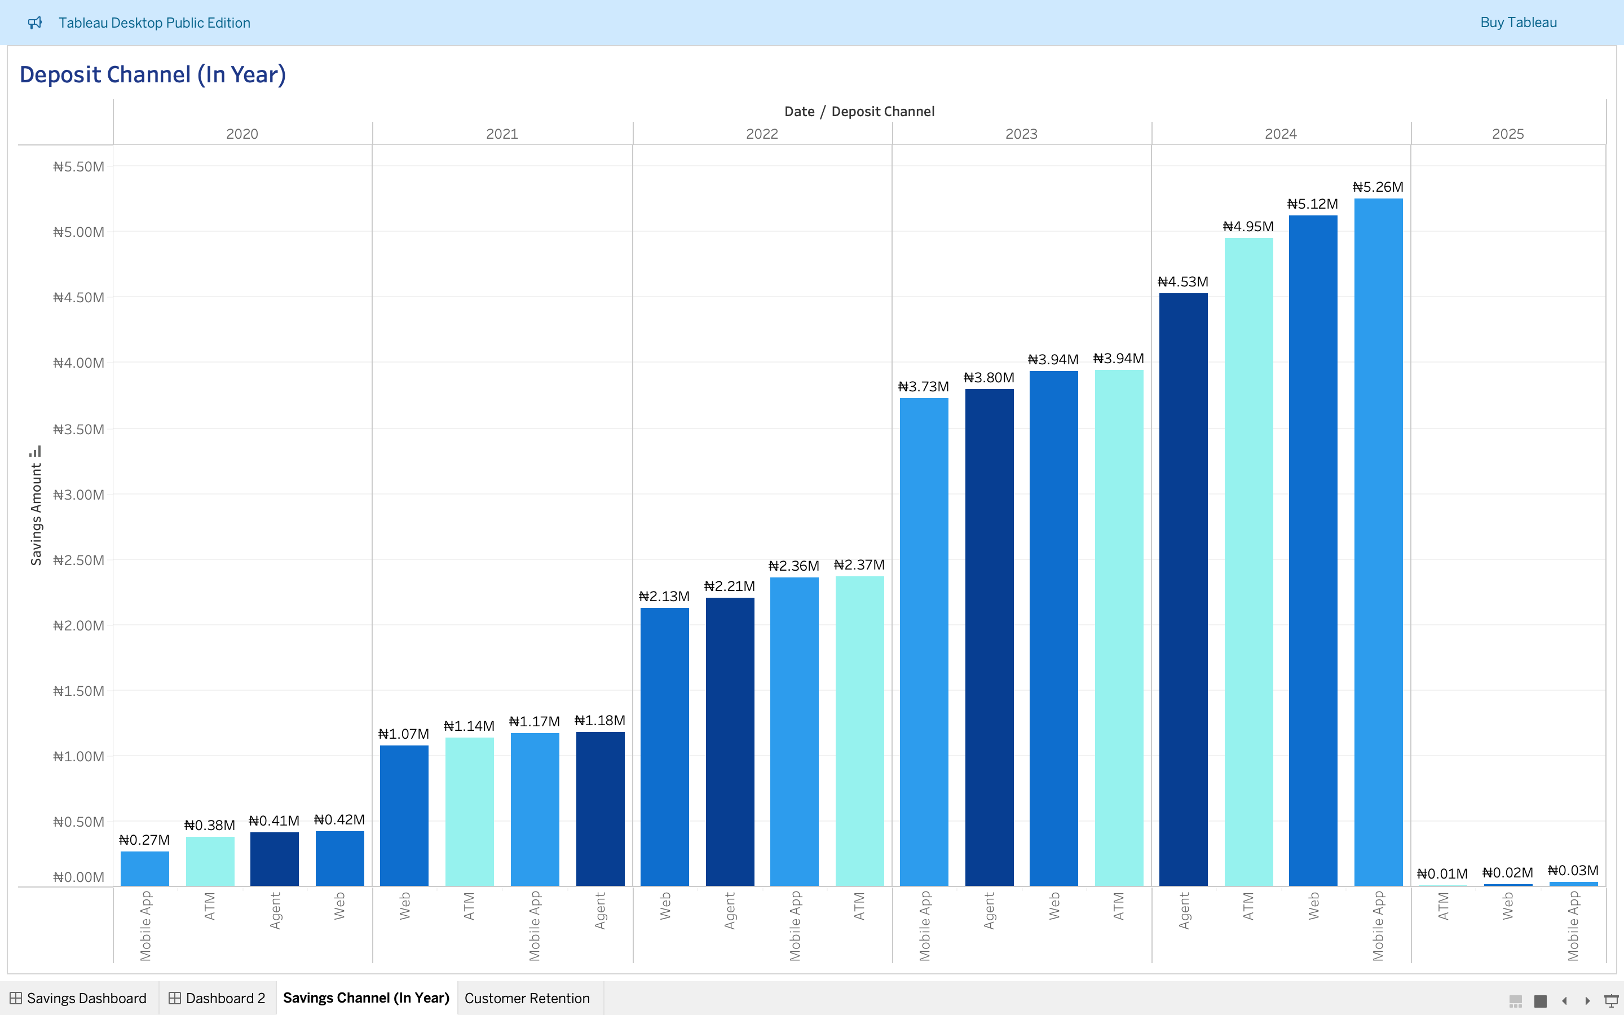
Other Insights
This chart highlights the strong growth in savings across all deposit channels up to 2024, with Mobile App and ATM being the most popular.

Slide 6
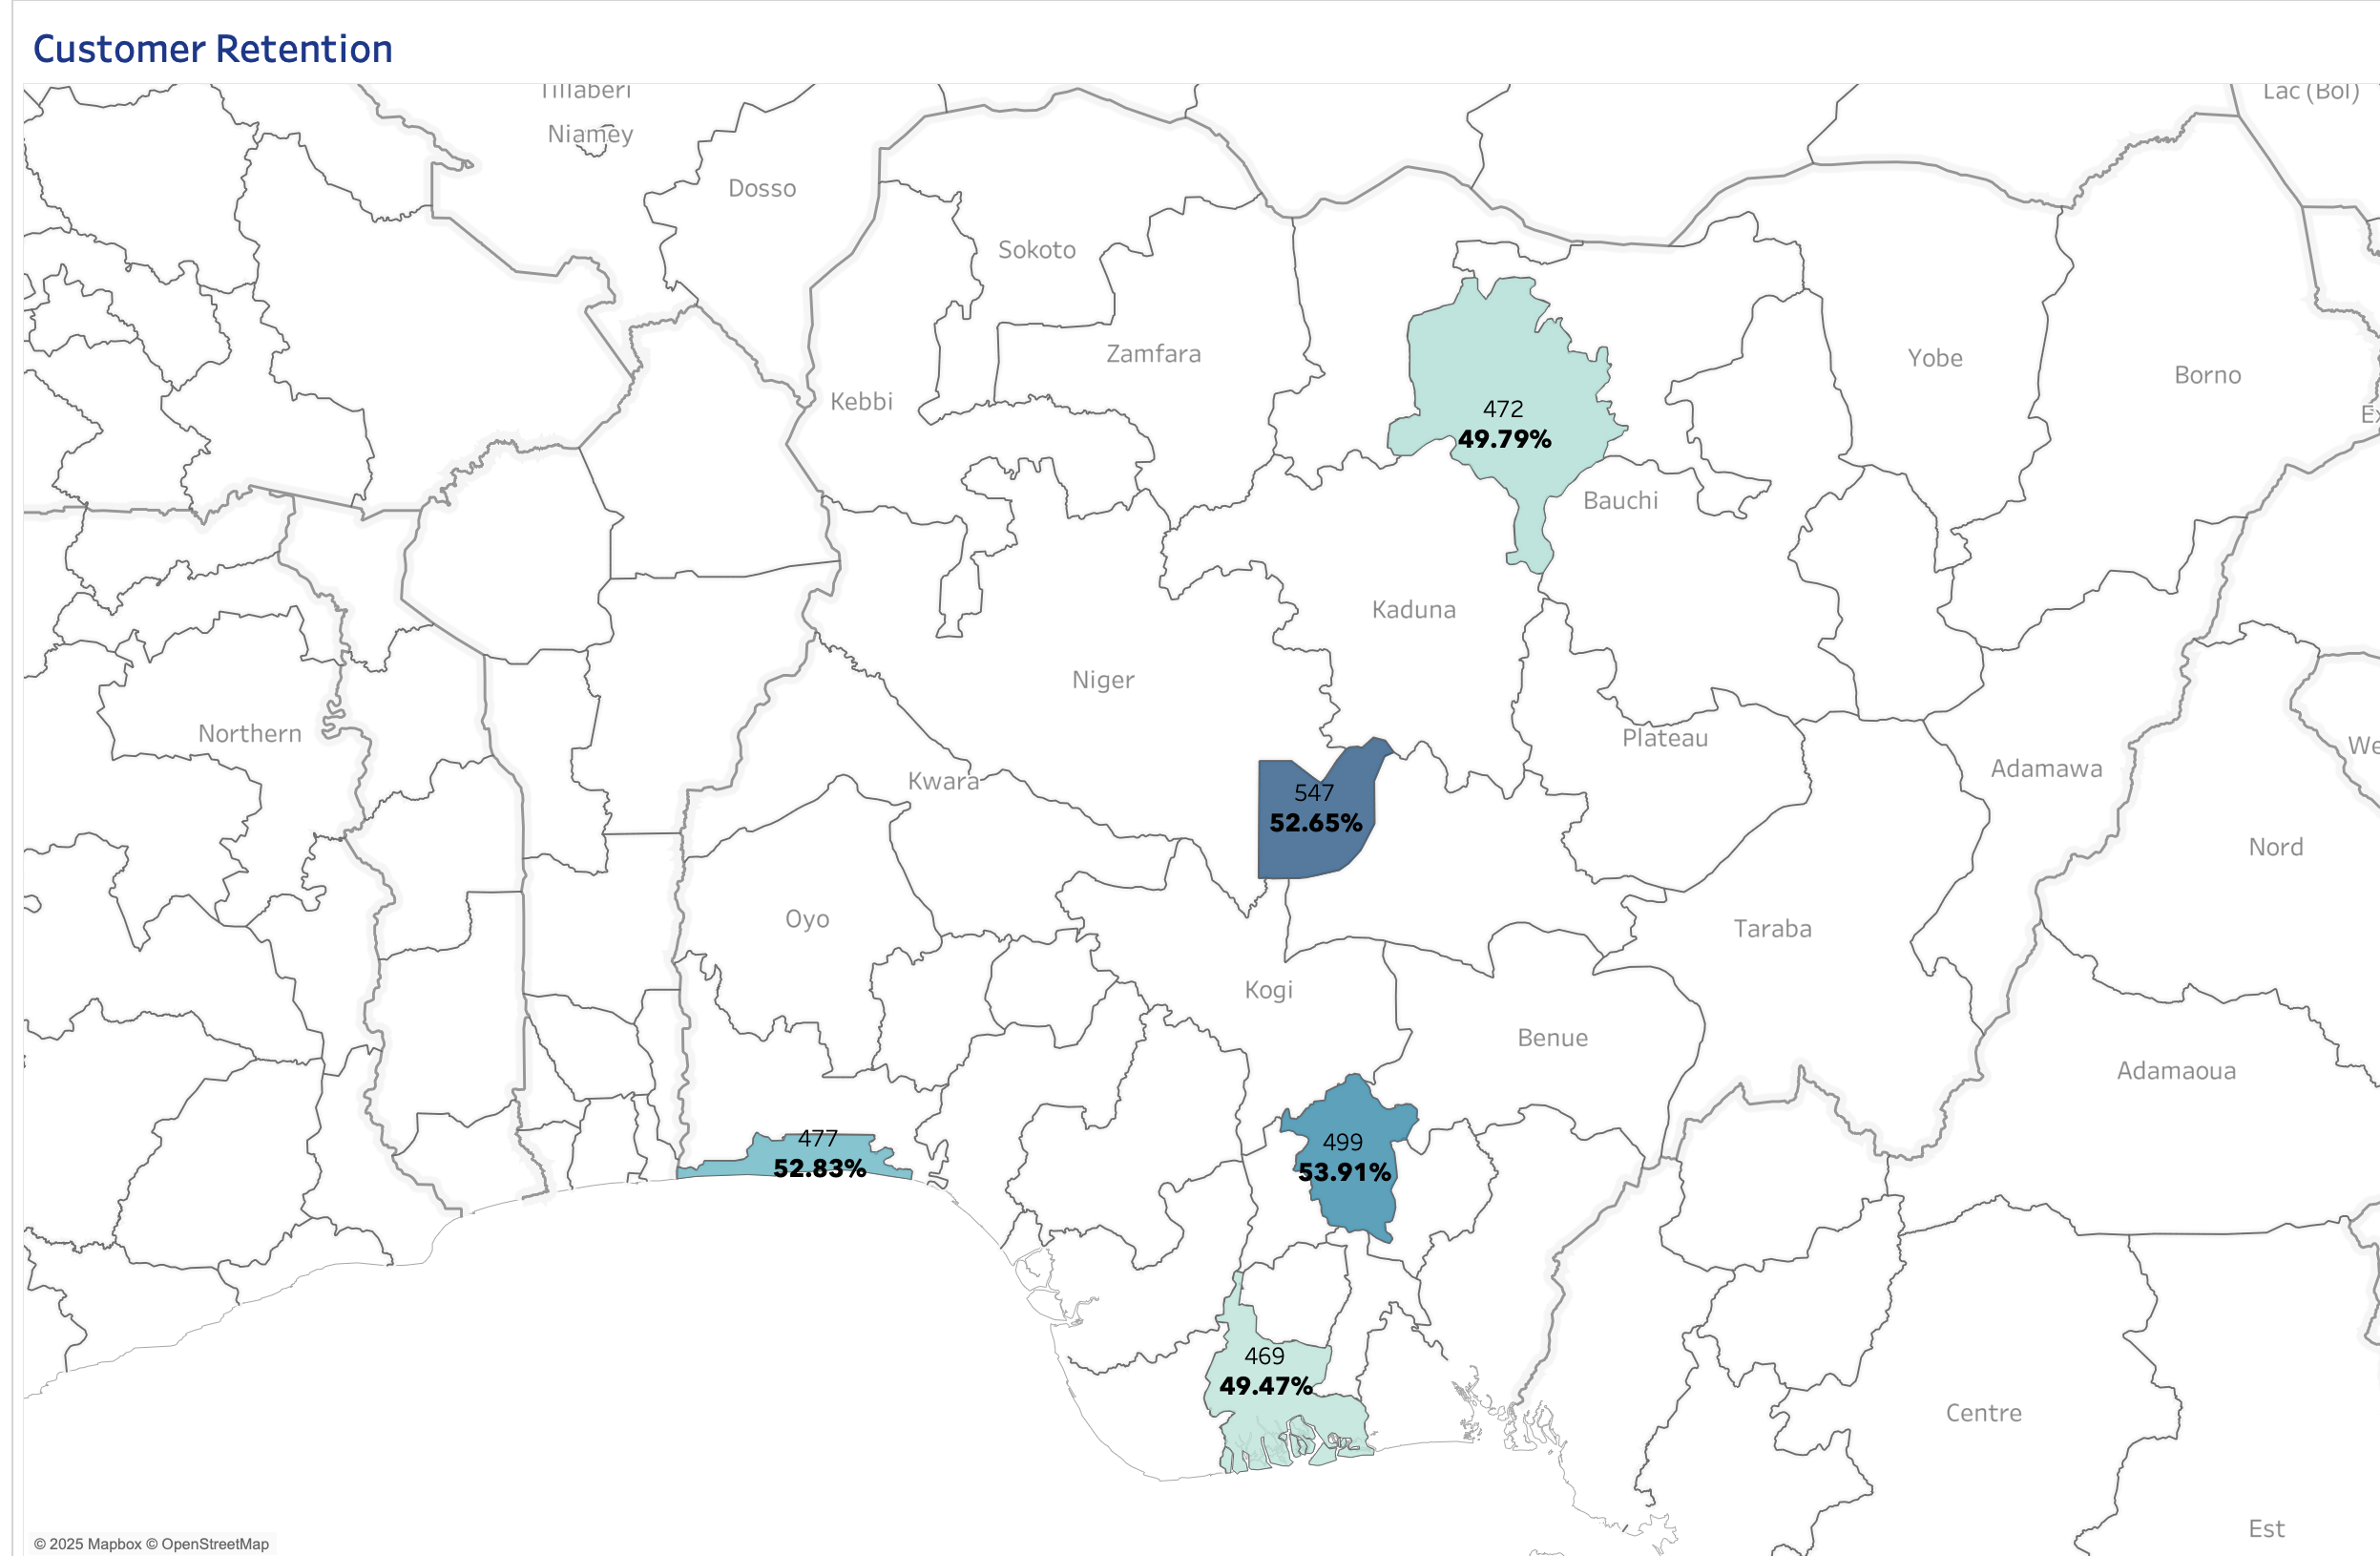
Other Insights
This map provides a geographical overview of customer retention. While retention rates are generally around the 50% mark in the displayed regions, there are notable differences. Enugu shows the highest customer loyalty, while Port Harcourt has the lowest. Understanding the local dynamics and customer behavior in each region can help tailor strategies to improve customer retention across the board.

Slide 7
Recommendation
1. Optimize Deposit Channels:
Prioritize Mobile App and ATM channels with UX enhancements, reliability improvements, and targeted promotions.
Revitalize Agent and Web channels through friction reduction, agent training, and tailored promotions.
2. Boost Customer Retention:
Address low retention in Port Harcourt and Kano via region-specific strategies (e.g., surveys, competitor analysis, localized offers).
Replicate Enugu’s retention success and deploy a CRM system for personalized engagement and proactive churn prevention.
3. Data-Driven Strategy Refinement:
Segment customers for hyper-targeted campaigns and product personalization.
Monitor metrics (savings trends, channel usage, retention) and integrate qualitative feedback (surveys, focus groups) for agile decision-making.

